Slide 1

Chapter 2
Welcome App
CPD-4493
Mobile Development II

Slide 2
Review
Course Outline
  Rules and Regulations
Social Media and Communication Brief
Introduction to Android
Knowing Your Tools
  Eclipse, Git and GitHub

Slide 3
Today
Welcome App
  Updated files for L
  Tech Overview
  Creating an App
  Android Dev Tools Window
  Building the GUI
  Running the Welcome App
  Making Your App Accessible
  Internationalizing Your App

Slide 4
Updated files for L
  Create an AVD of the nexus 4 & run it
  Import the Project as an Existing Android Project
  Set the Manifest to targetSdkVersion="L" and minSdkVersion="L"
  Right-click on the project in the Project Explorer
  Select Android
  Under Project Build Target check Android L (Preview)
  Apply, OK
  Save your work
  Restart Eclipse, but leave the AVD running

Slide 5
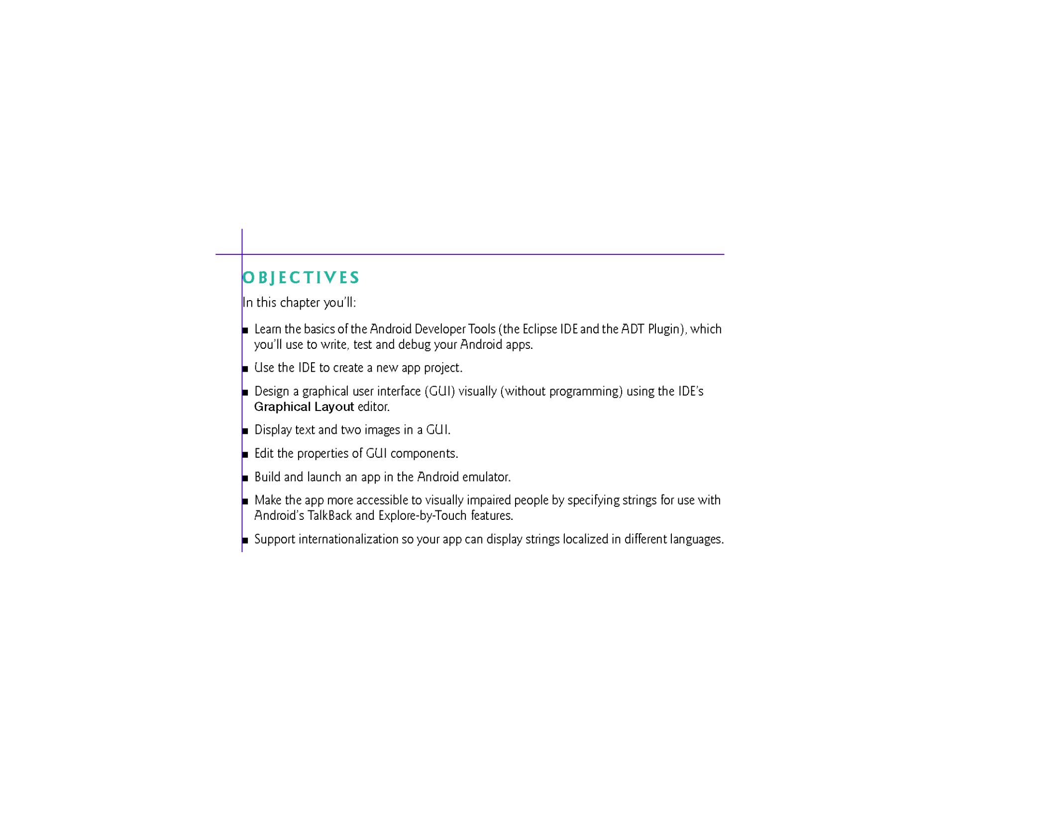
© Copyright 1992-2015 by Pearson Education, Inc. All Rights Reserved.

Slide 6
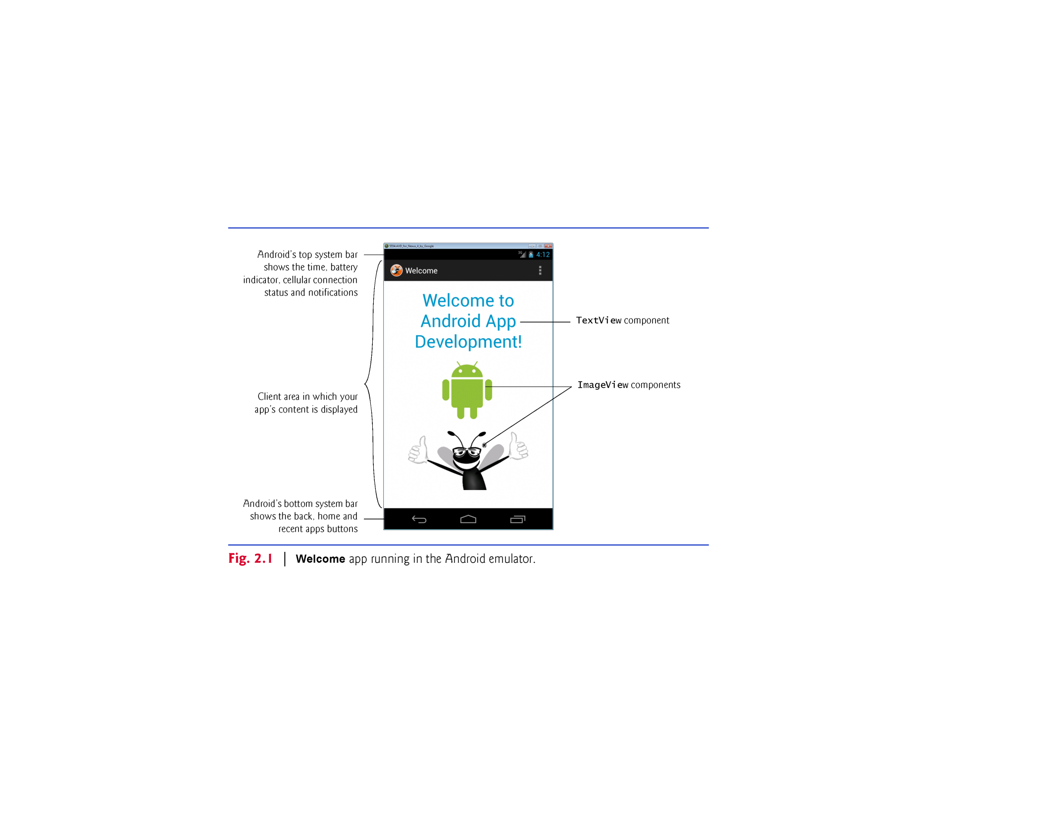
Android Developer Tools IDE
  Used to create new projects
TextView & ImageViews
App Resources
  Good practice to define all Strings & Numerics in resource files
Accessibility
  TalkBack
  Explore by Touch
Internationalization
  Custom TextView & ImageViews accessibility strings for different locales
© Copyright 1992-2015 by Pearson Education, Inc. All Rights Reserved.

Slide 7
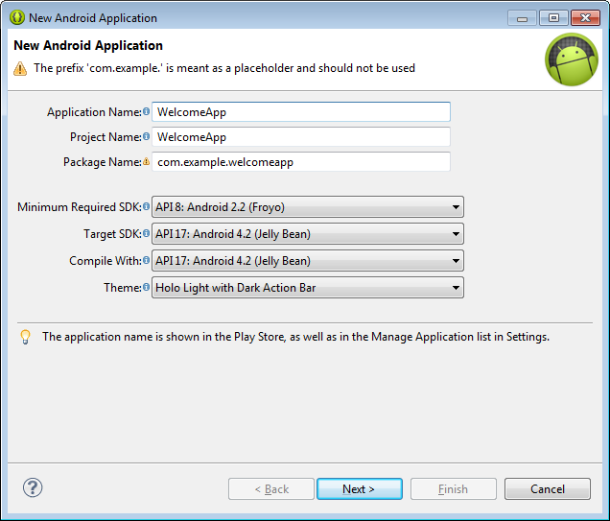
2.3 Creating an App – Creating a New Project
Application Name as Appears on Google Play
Project Name in Eclipse
Name of Java Package
SDK Settings
Choose the Android Version to Use and Compile With
Give the App a Name and Click Next
© Copyright 1992-2015 by Pearson Education, Inc. All Rights Reserved.

Slide 8
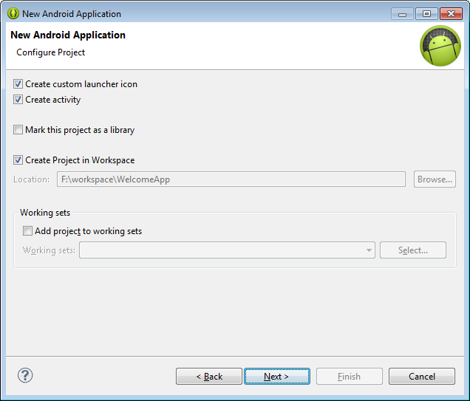
2.3 Creating an App – Creating a New Project
Allows Custom Icon Setup
Creates a Default Activity with Templates
Will This Be Used By Others?
Use Eclipse's Workspaces?
Click Next

Slide 9
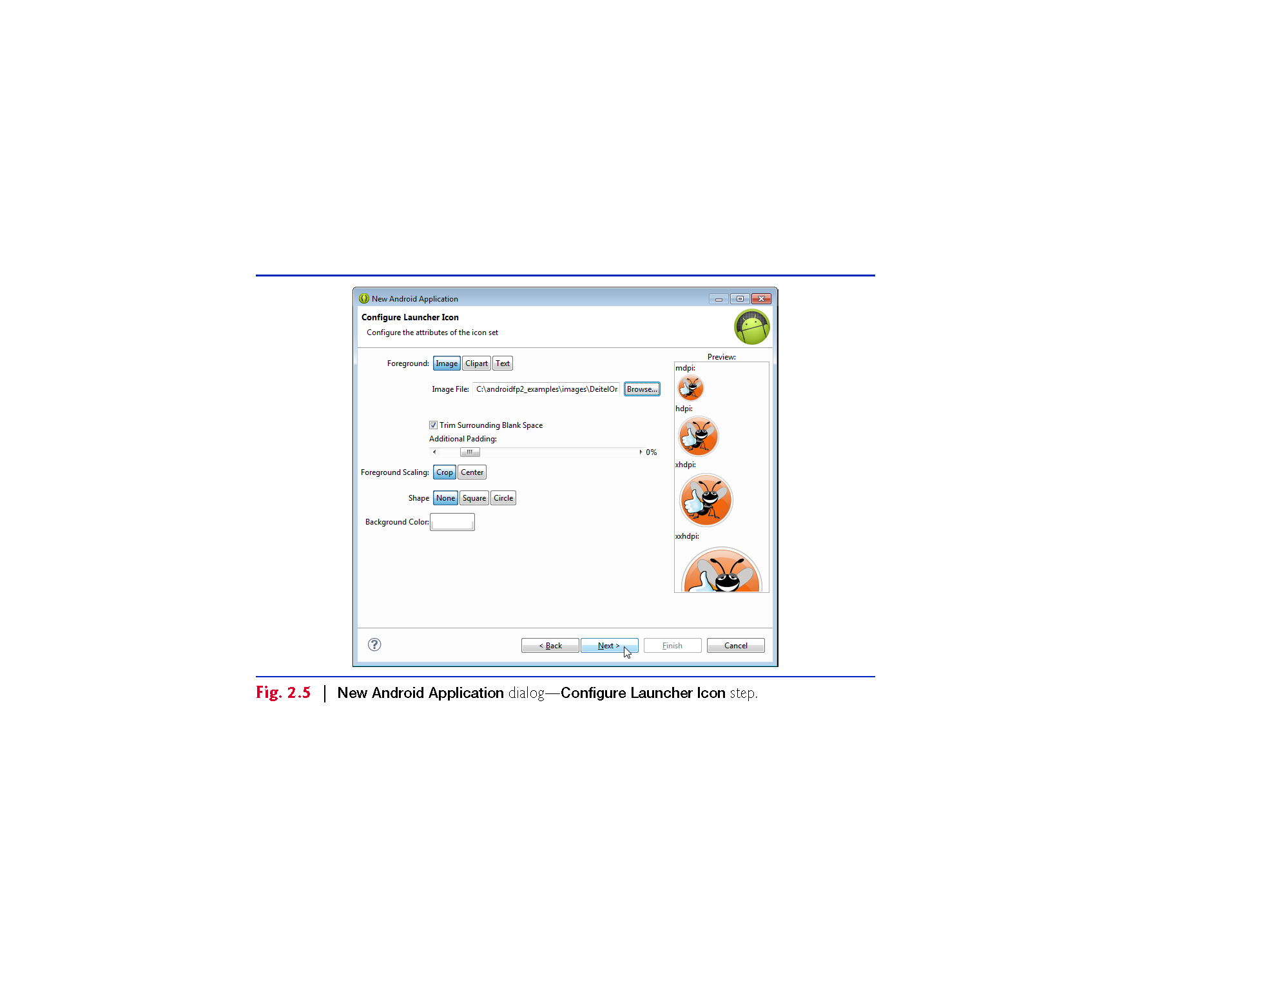
2.3 Creating an App – Creating a New Project
Original Icon Design
Important for Some Files
Cut, Squish or Stretch
Crop to Square or Circle?
Background Color
Play Around and Click Next
© Copyright 1992-2015 by Pearson Education, Inc. All Rights Reserved.

Slide 10
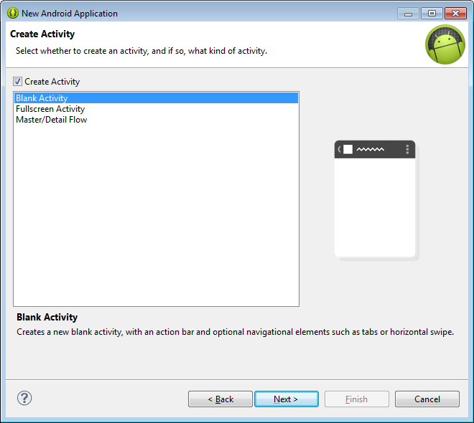
2.3 Creating an App – Creating a New Project
Select a Default Activity Type
Visual Preview
Select Blank Activity and Click Next
© Copyright 1992-2015 by Pearson Education, Inc. All Rights Reserved.

Slide 11
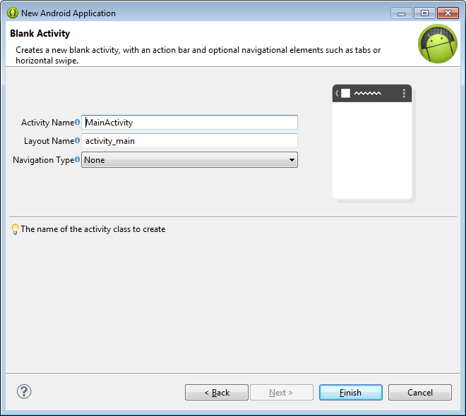
2.3 Creating an App – Creating a New Project
Name the Activity
Name the Layout File
Choose Navigation
Accept the Defaults and Click Next
© Copyright 1992-2015 by Pearson Education, Inc. All Rights Reserved.

Slide 12
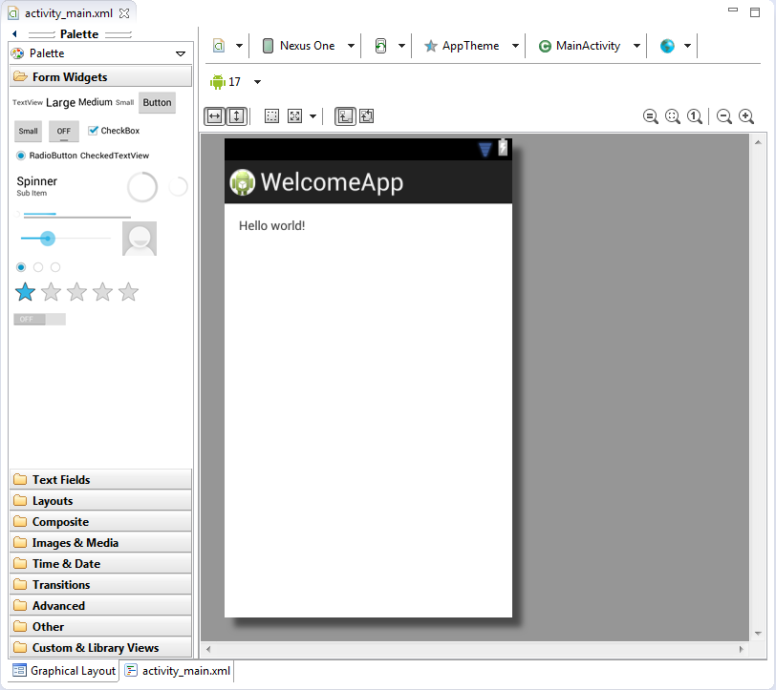
2.4 Android Developer Tools Window
File Name
Activity Attached to Layout
Current Device Constraints
Current API Model
App Preview
Widget Palette
View Choice (Visual/XML)
© Copyright 1992-2015 by Pearson Education, Inc. All Rights Reserved.

Slide 13
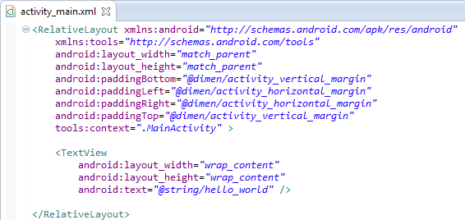
2.4 Android Developer Tools Window
Root Element
Height and Width
Padding
Entity Layout and Content
Resource Reference
© Copyright 1992-2015 by Pearson Education, Inc. All Rights Reserved.

Slide 14
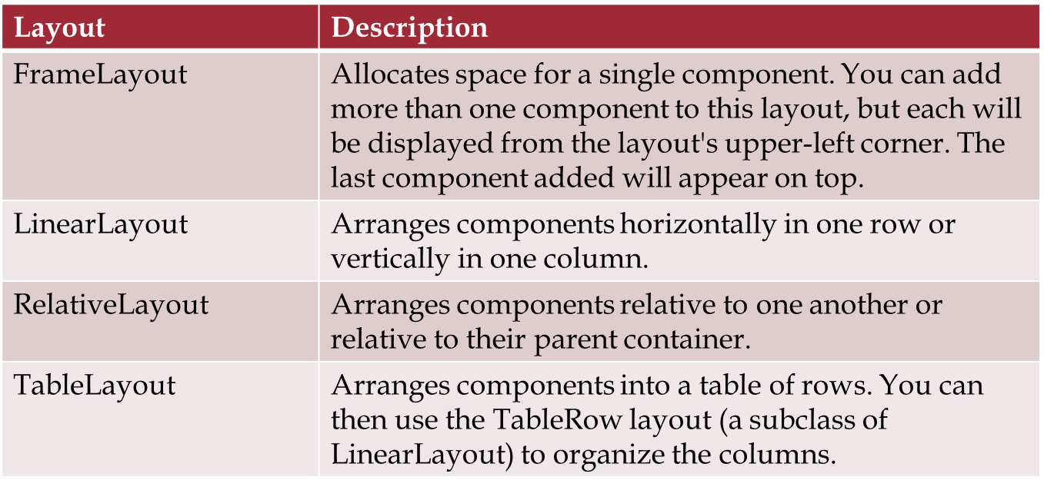
Types of Layouts

Slide 15
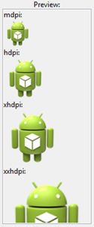
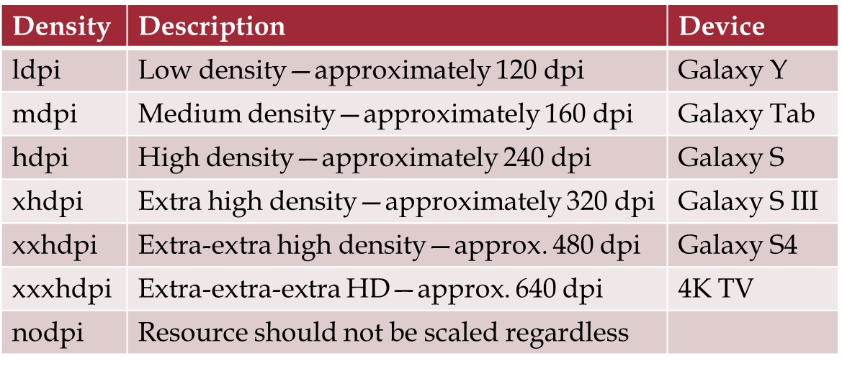
2.5 Images & Screen Sizes/Resolutions
Not all screens are created equal. The biggest factor is pixel-density:
  dpi (dots per inch)

Slide 16
2.5 Supporting Multiple Screens
The best way to support multiple screens is to use layouts that scale:
  RelativeLayout
  TableLayout
And to acquire assets for the various densities

Slide 17
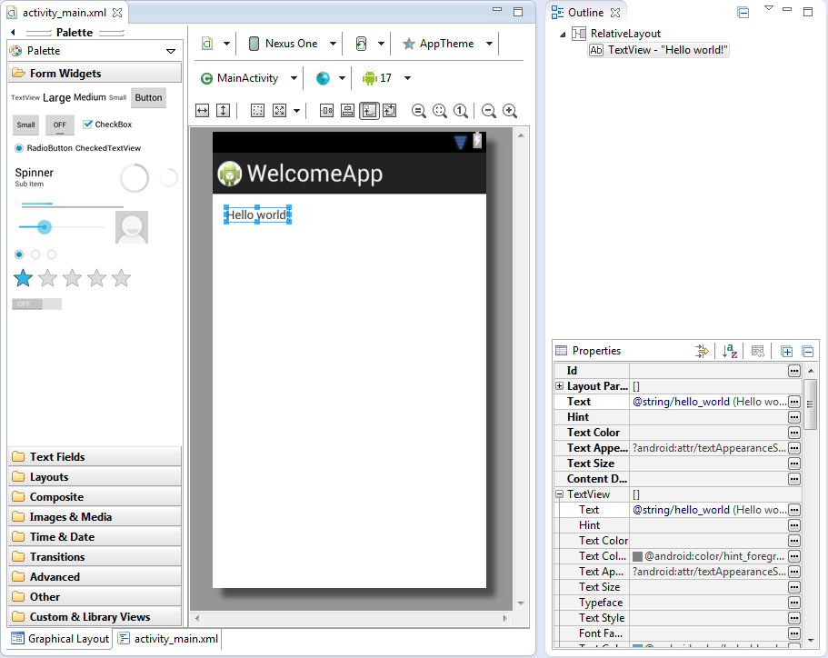
2.5 Building the Welcome App
Click the TextView
Change Properties
Click … By
Text Size
© Copyright 1992-2015 by Pearson Education, Inc. All Rights Reserved.

Slide 18
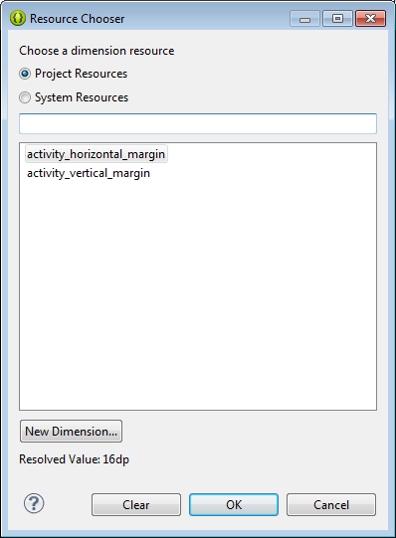
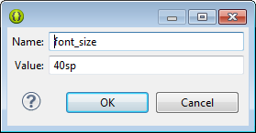
Working with Resources
Project or System Resources
Select from Existing Resources
Create a New One!
Click New Dimension
Give a Name and a Value

Slide 19
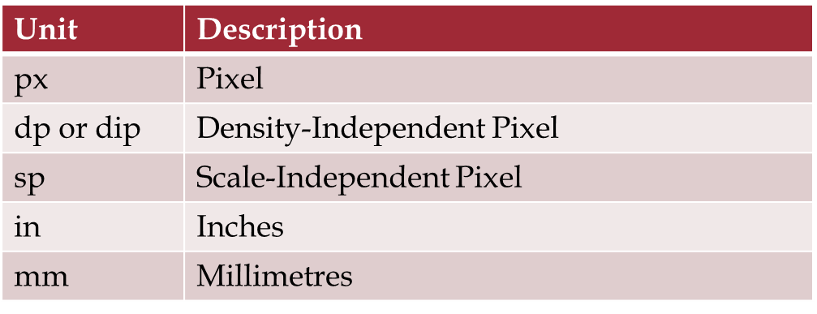
2.5 Working with Dimensions
There are several different dimension types in Android, the most responsive/scalable ones are dp and sp.
© Copyright 1992-2015 by Pearson Education, Inc. All Rights Reserved.

Slide 20
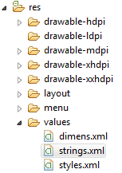
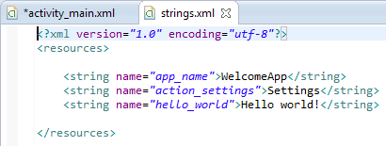
2.5 Working with String Resources
Two Ways:
  Work with the Resource Dialogs:
  Work with the XML File Directly:
Click … By Text

Slide 21
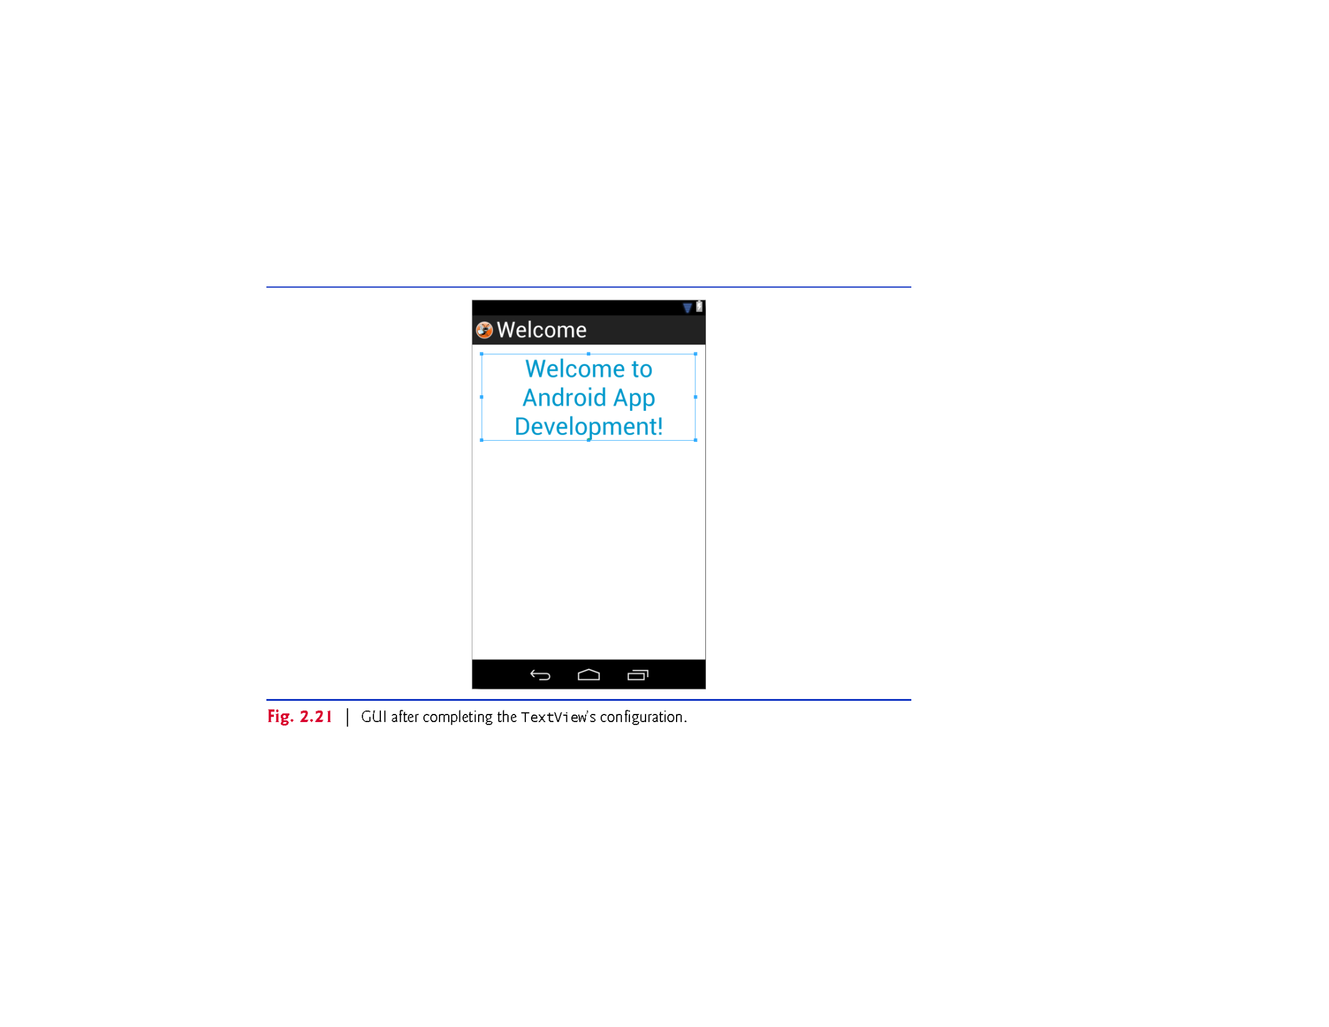
2.5 Working with String Resources
© Copyright 1992-2015 by Pearson Education, Inc. All Rights Reserved.

Slide 22
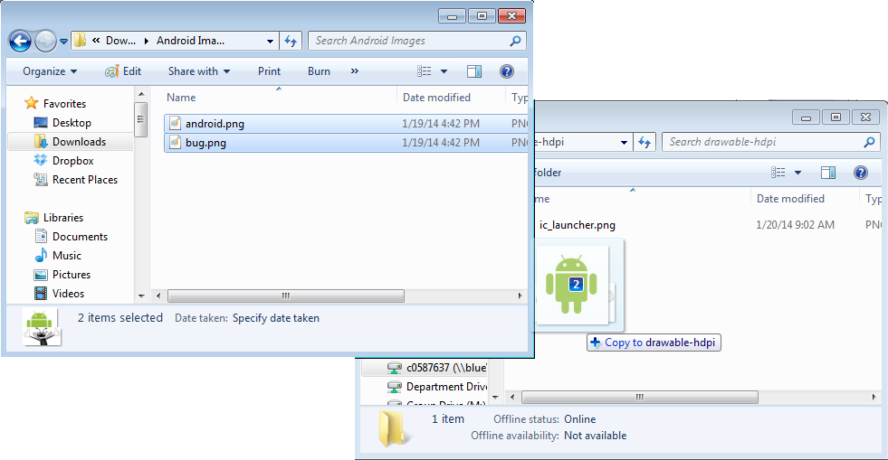
2.5 Adding Images
Step One: Put the Images in the Drawable Folder
Original Location
F:\workspace\WelcomeApp\res\drawable-hdpi

Slide 23
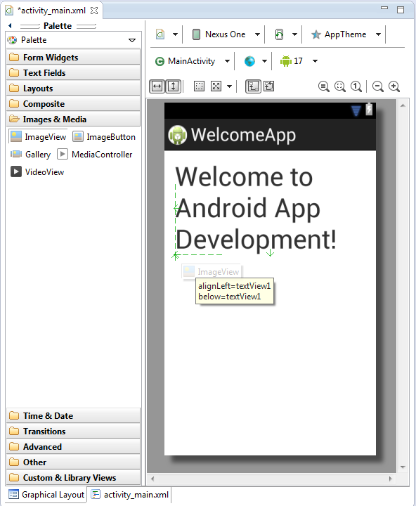
2.5 Drag an ImageView Onto the Layout
Select Images & Media
Click and Drag an ImageView
Align the ImageView

Slide 24
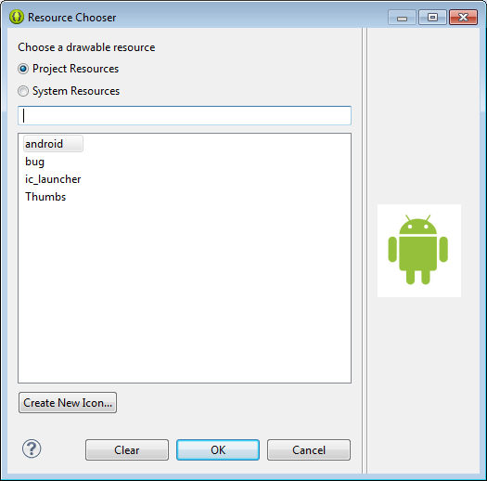
Choose the Drawable Resource
Select the android Icon
If the Android and Bug do not appear:
Hit Cancel!
Make sure the images are in the correct drawable folder in the project
Save the Project
Try to Re-Build the ImageView
Click OK

Slide 25
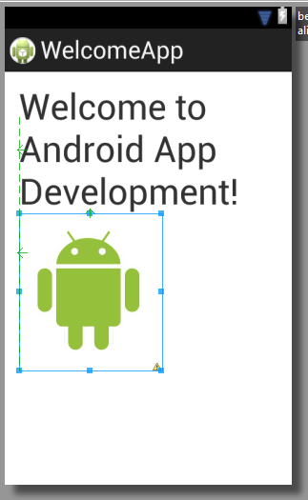
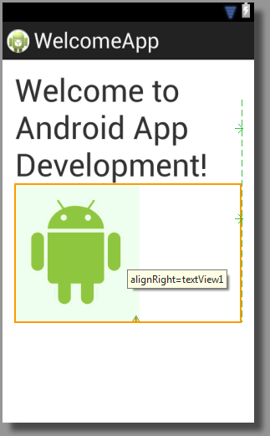
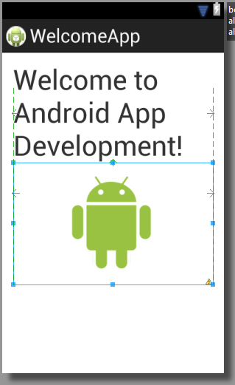
Centering the Icon
Grab the Handle
Drag to Margin
Ta-Da!

Slide 26
Finishing Touches
Repeat the ImageView process for the Bug
Modify the TextView to be:
  Centered – Set Gravity to Center
  Blue – Edit styles.xml to make a Color with value #0000FF
  Bold – Set Text Style to Bold

Slide 27
Re-Examining the XML File
Take a Second Look at the XML File
Notice:
  The root element has not changed
  There are three child elements:
    One TextView, Two ImageViews
All the properties we created with the GUI are portrayed here in this file.
Note: Warnings Give Hints of Where to Improve

Slide 28
2.7 Accessibility
TalkBack not available in AVD
  On a test device only
  Settings / Accessibility
Content Description for ImageViews:
  Select droidImageView in Graphical Layout editor
  In Properties click … next to Content Description
  New String
  In String field “Android Logo”
  In R.string field android_logo
  In the Resource Chooser specify android_logo for droidImageView’s Content Description
  Repeat for bugImageView (page 61)

Slide 29
2.8 Internationalizing Your App
strings.xml
  Default is used if a language-specific one does not exist
  Language-specific ones are stored in a values-** folder
    values-fr –> French
    values-es -> Spanish
  Regional ones are stored in a values-**-r** folder
    values-en-rUS –> American English
    values-en-rGB -> British English
To make a local folder:
  In the Package Explorer Right-click on the res folder
  Select New > Folder
  Call it values-es
Copy strings.xml:
Paste into values-es folder

Slide 30
2.8 Internationalizing Your App
Localizing the strings
  Double-click strings.xml in the values-es folder
  Page 65 steps 2 – 6 show the Spanish translations to type
Testing in Spanish
  In the AVD touch the launcher (…) button and select ‘Settings’
  Scroll to PERSONAL and select Languages & input
  Select Language and select Espanol (Espana)
  Run the App to see the Spanish
  Page 65 Shows how to return to English

Slide 31
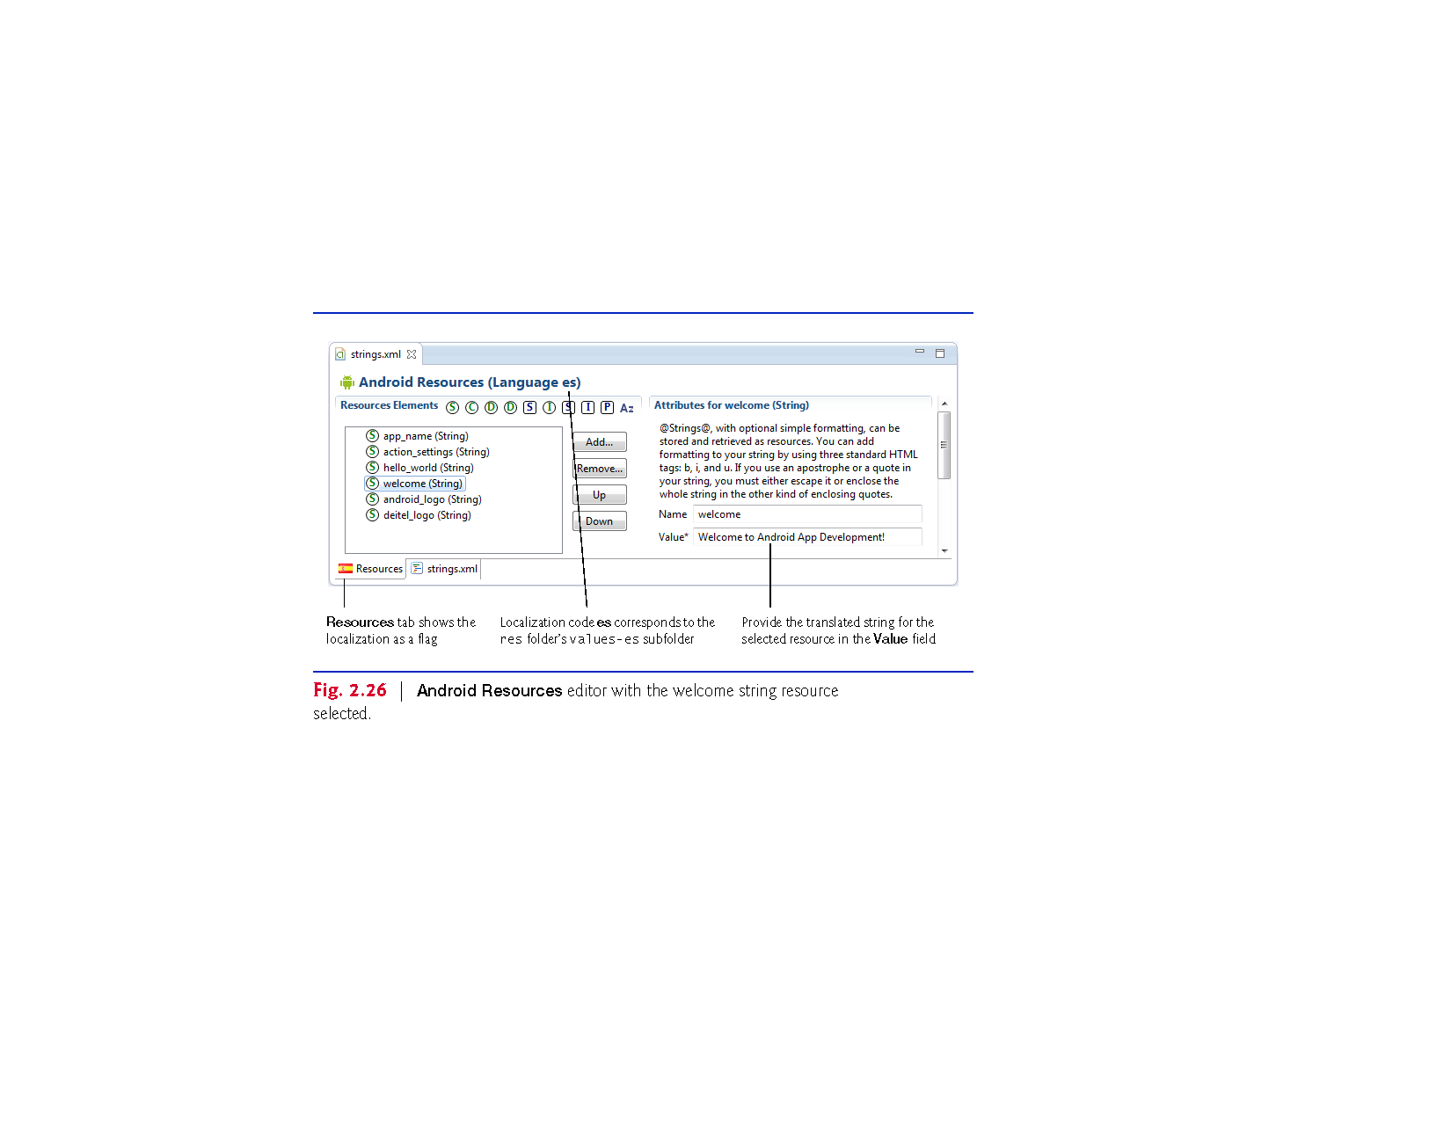
2.8 Internationalizing Your App
© Copyright 1992-2015 by Pearson Education, Inc. All Rights Reserved.

Slide 32
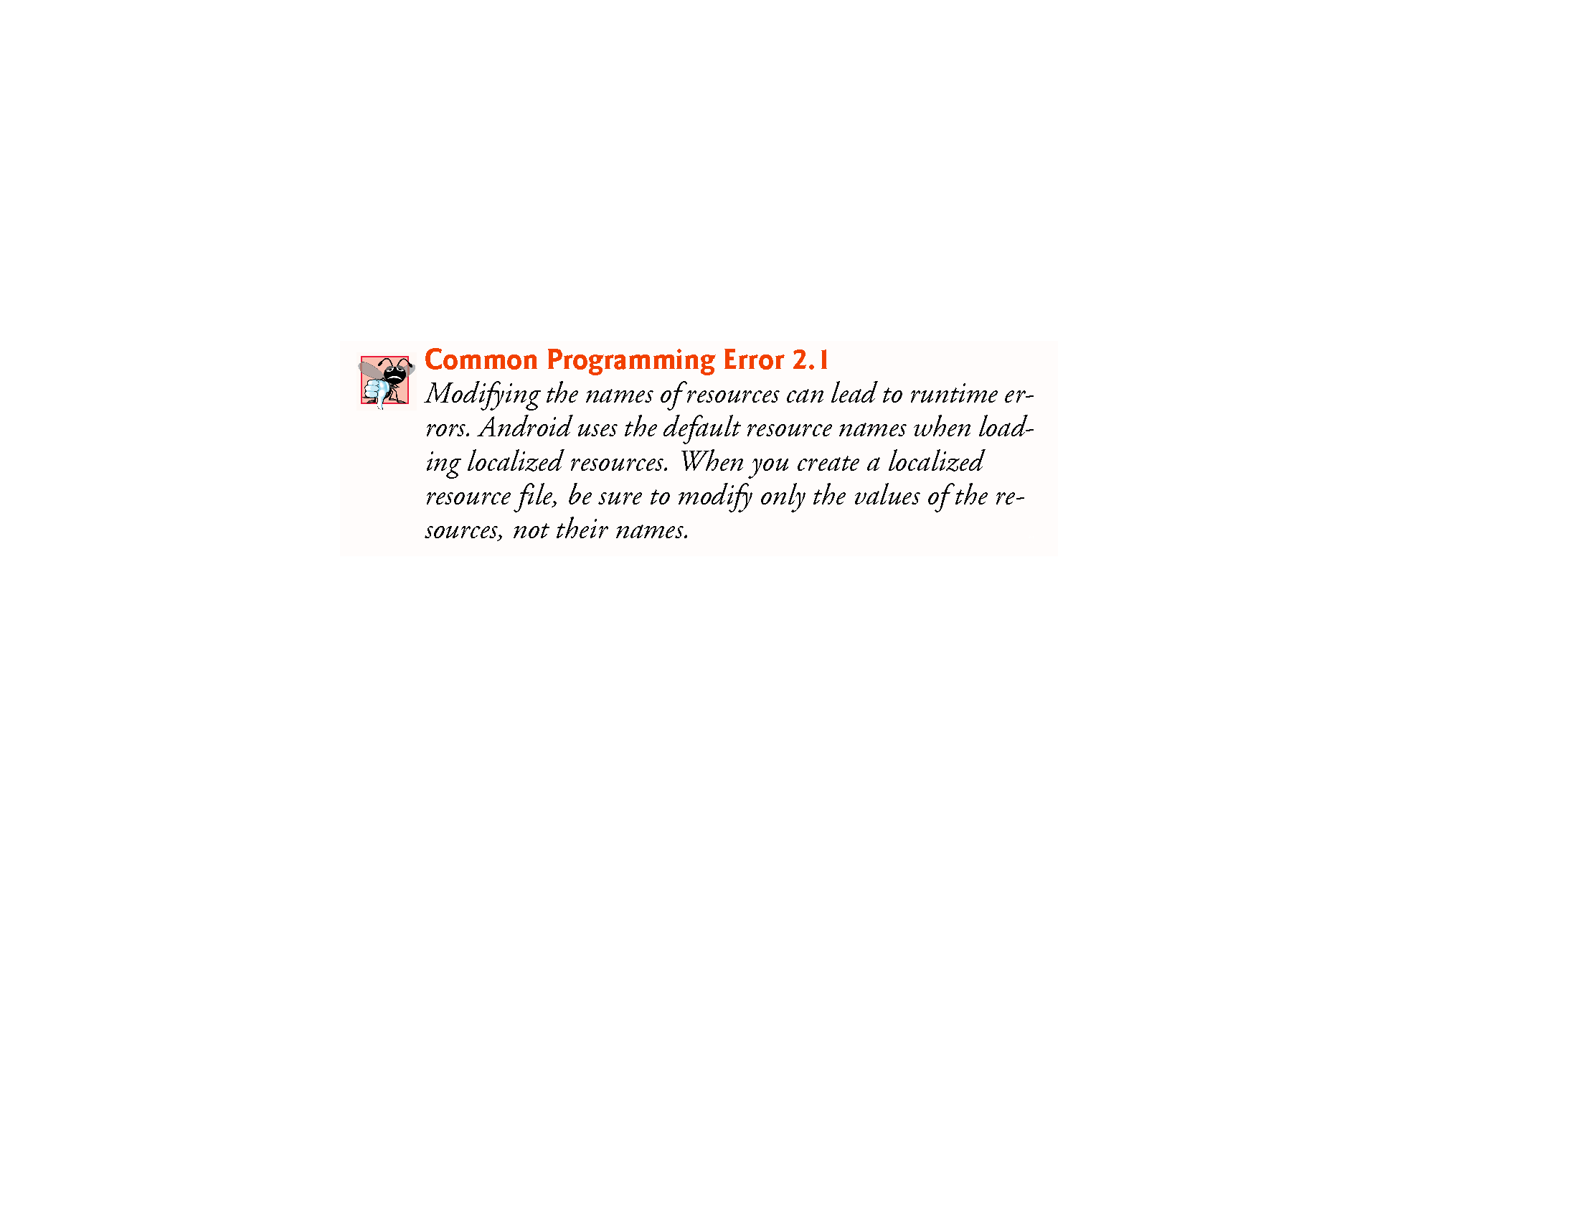
© Copyright 1992-2015 by Pearson Education, Inc. All Rights Reserved.

Slide 33
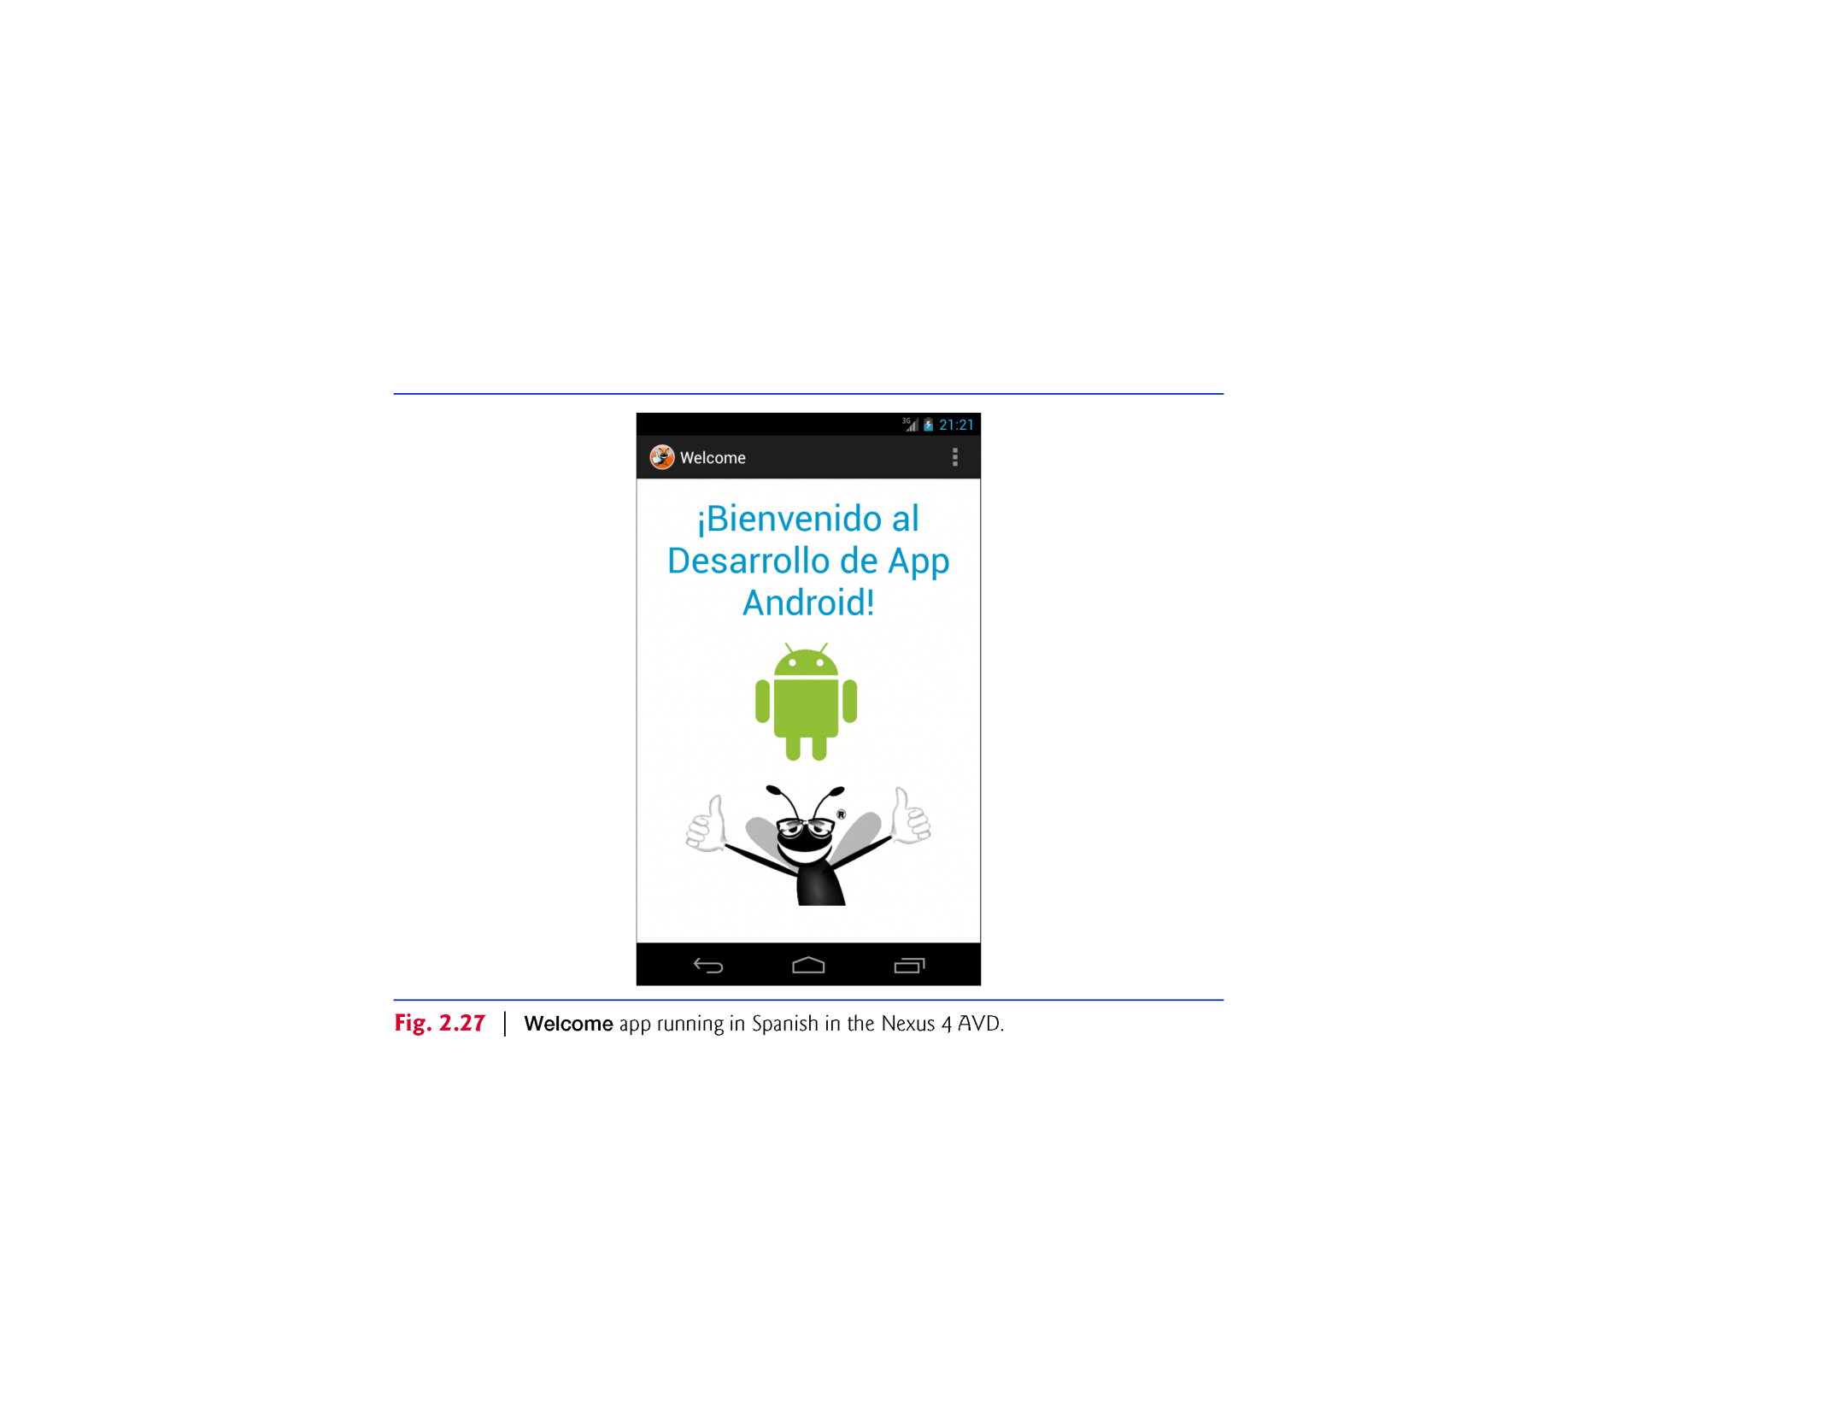
© Copyright 1992-2015 by Pearson Education, Inc. All Rights Reserved.

Slide 34
Today
Welcome App
  Updated files for L
  Tech Overview
  Creating an App
  Android Dev Tools Window
  Building the GUI
  Running the Welcome App
  Making Your App Accessible
  Internationalizing Your App

Slide 35
Assignment No.1
From page 68 of Chapter 2, complete Exercises 2.5, 2.6, & 2.7 – Scrapbooking App
Store your files in a GitHub repository
When complete, export the zip file and upload it into the appropriate dropbox in D2L

Slide 36
Next Week
Tip Calculator App
  Class Activity
  Activity Lifecycle Methods
  Arranging View
  Creating & Customizing the GUI
  Locale-specific Currency
  Adding Functionality
  AdnroidManifest.xml

